Slide 1
Wireless MAC protocols
Prof. Malathi Veeraraghavan
Elec. & Comp. Engg. Dept/CATT
Polytechnic University
mv@poly.edu
EL604: Wireless & Mobile Networking

Slide 2
Classification of wireless MAC protocols
Wireless MAC protocols
Fixed-assignment schemes
Random-access schemes
Demand assignment schemes
Circuit-switched
CL packet-switched
CO packet-switched

Slide 3
Outline
Need for wireless MAC protocols
Obtain assignment of resources per call
  ala circuit switching
  fixed assignment
Obtain assignment of resources per packet
  ala packet switching
    CL flavor: random-access
    CO flavor: demand-assignment

Slide 4
Random access MAC protocols
Comparable to connectionless packet-switching
No reservations are made; instead a wireless endpoint simply starts sending data packets
What can happen?

Slide 5
Answer
Collision
  Need to avoid collisions or detect collisions and retransmit
What’s the cost of being too careful to avoid collisions?
  Utilization will be sacrificed

Slide 6
Various random-access
MAC schemes
ALOHA
Slotted ALOHA
CSMA
CSMA/CD
CSMA/CA

Slide 7
ALOHA
Simplest scheme
True free-for-all. When a node needs to send, it does so. It listens for an amount of time equal to the maximum round trip delay plus a fixed increment. If it hears an acknowledgment, fine; otherwise it resends after waiting a random amount of time. After several attempts, it gives up.
Low delay if light load
Max. utilization: 18%

Slide 8
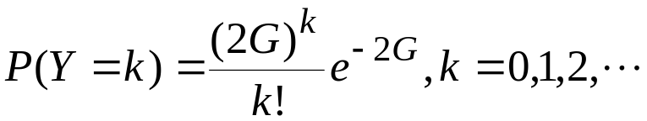
Analysis of ALOHA
First transmission
Retransmission
t-X
t
t+X
t+X+2t_{prop}
t+X+2t_{prop}+B
backoff
period
vulnerable
period
t_{prop}: maximum one-way propagation delay between any two stations
X = L/R, L: packet length (constant) R: rate
S: Throughput (also number of new arrivals/X sec if we assume that all packets eventually make it)
G: arrival rate of new + retransmitted packets/X sec; Poisson arrival processes
Probability of successful transmission is that there are no additional transmissions in the vulnerable period of 2X
Y: random variable denoting number of total arrivals in 2X seconds

Slide 9
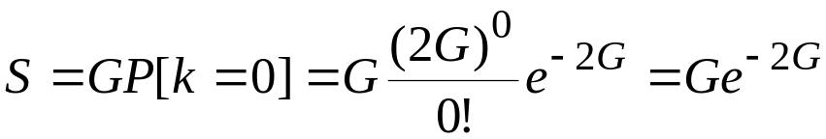
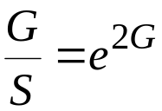
Analysis of ALOHA contd.
The throughput S is the total arrival rate G times the probability of there being no collision
The average delay depends on average number of transmission attempts per packet
The average number of unsuccessful attempts G/S-1
Average delay is approximated by

Slide 10
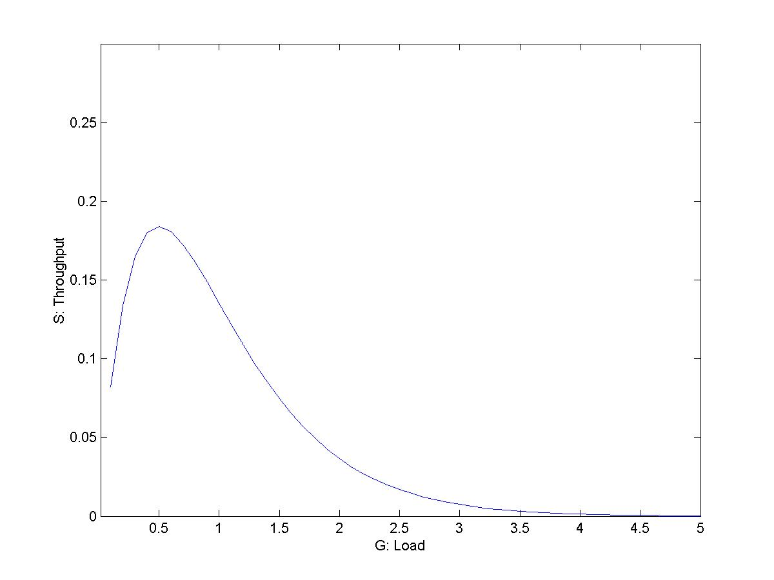
ALOHA throughput
Maximum
throughput
is 18% at
G = 0.5

Slide 11
Slotted ALOHA
Competition to send only occurs at the start of each slot (equal to X)
Vulnerable period is X (not 2X as in ALOHA)
What is maximum throughput?

Slide 12
CSMA
Carrier Sense Multiple Access
  sense carrier
  if idle, send
  wait for ack
    If there isn’t one, assume there was a collision, retransmit
Vulnerable period: one t_{prop}

Slide 13
Different techniques
1-persistent:
  if busy, constantly sense channel
  if idle, send immediately
  if collision is detected, wait a random amount of time before retransmitting
Non-persistent:
  sense channel when station has a packet to send
  if busy, wait a random amount of time before sensing again;
  if idle, transmit as soon as it is idle
  collisions reduced because sensing is not immediately rescheduled
  drawback: more delay
p-persistent: combines 1-persistent goal of reduced idle channel time with the non-persistent goal of reduced collisions.
  sense constantly if busy and the station needs to send a packet
  when the channel becomes idle, transmit packet with probability p
  with probability 1-p station waits an additional t_{prop} before sensing again

Slide 14
CSMA/CD
Ethernet (also 802.3) standardizes the 1-persistent CSMA/CD multi-access control protocol.
  Each station listens before it transmits.
  If the channel is busy, it waits until the channel goes idle, and then it transmits.
  If the channel is idle it transmits immediately. Continue sensing.
  If collision is detected, transmit a brief jamming signal, then cease transmission, wait for a random time, and retransmit.
    collision detection is not by waiting for an ACK

Slide 15
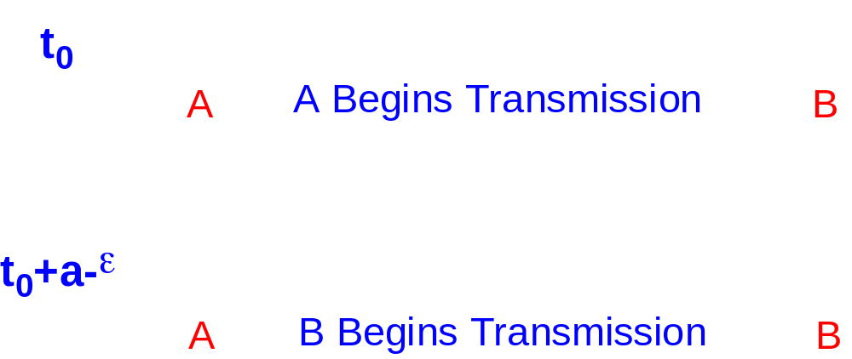
Collisions in Ethernet
The collision resolution process of Ethernet requires that a collision is detected while a station is still transmitting.
Assume: max. propagation delay on the bus is a.

Slide 16
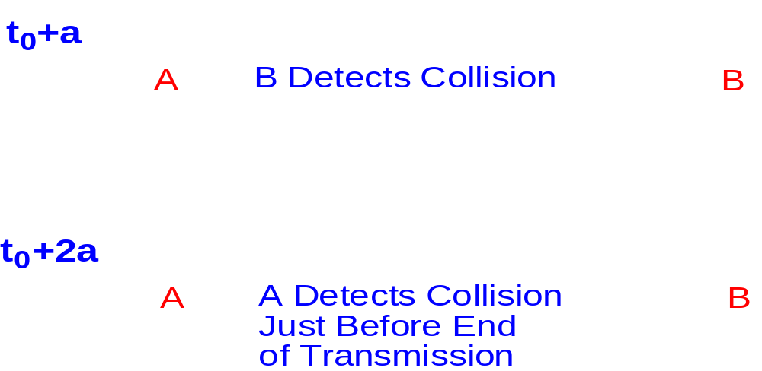
Collisions in Ethernet
Restrictions: Each frame should be at least twice as long as the time to detect a collision (2 · maximum propagation delay).

Slide 17
CSMA/CD
CSMA/CD:
  In CSMA, if collision occurs, need to wait till damaged frames have fully propagated. For long frames compared to propagation delay, this could lead to significant waste of capacity. So add collision detection.
  Rule: Frames should be long enough to allow collision detection prior to the end of transmission

Slide 18
Exponential Backoff Algorithm
If a station is involved in a collision, it waits a random amount of time before attempting a retransmission.
The random time is determined by the following algorithm:
    Set “slot time” to 2a.
    After first collision wait 0 or 1 time unit.
    After i-th collision, wait a random number between 0 and 2 ^{i}-1 time slots.
    Do not increase random number range if i=10.
    Give up after 16 collisions.

Slide 19
Wireless 802.11 LAN
Uses CSMA/CA
Why CA and CD?
  Difficult to detect collisions in a radio environment – why?
  Hidden station problem:
    Two mutually far away stations A and C want to send to B.
    At A and C, channel appears idle
    But collision occurs at B

Slide 20
Why is it difficult to detect collisions in a radio environment?
A transmitting station cannot effectively distinguish incoming weak signals from noise and the effects of its own transmission; need a full duplex radio to listen and transmit on same frequency (not true in FDD systems)

Slide 21
Mechanisms for CA
Use of Request-To-Send (RTS) and Confirm-to-Send (CTS) mechanism
  When a station wants to send a packet, it first sends an RTS. The receiving station responds with a CTS. Stations that can hear the RTS or the CTS then mark that the medium will be busy for the duration of the request (indicated by Duration ID in the RTS and CTS)
  Stations will adjust their Network Allocation Vector (NAV): time that must elapse before a station can sample channel for idle status
    this is called virtual carrier sensing
  RTS/CTS are smaller than long packets that can collide
Use of InterFrame Spaces (IFS)

Slide 22
802.11 MAC
IEEE 802.11 combines a demand-assignment MAC protocol with random access
  PCF (Point Coordination Mode) – Polling
    CFP (Contention-Free Period) in which access point polls hosts
  DCF (Distributed Coordination Mode)
    CP (Contention Period) in which CSMA/CA is used
stretching
CP
CFP
Frame
CFP
Super-frame
Foreshortened CFP

Slide 23
DCF
Distributed Coordination Function
This mode of 802.11 is a random access MAC
When a node needs to send data, it senses the medium. If idle, wait for a period of DIFS and if the medium is still idle after DIFS, send immediately.
If when the medium is sensed it is busy; then
  wait for medium to be idle for a DIFS (DCF IFS) period
  then decrement backoff timer until
    medium becomes busy again; freeze timer, OR
    timer reaches 0; transmit frame
  if two stations have their timers reach 0; collision will occur; for every retransmission attempt, increase the contention window (CW), idle period after a DIFS, exponentially; 2^{i} –1 starting with CW_{min}e.g., 7, 15, 31.

Slide 24
DCF mode transmission without RTS/CTS
DIFS
Data
source
SIFS
Ack
destination
CW
NAV
DIFS
other
Defer access
Random backoff time
Exercise: Show timing diagram for DCF mode with RTS/CTS

Slide 25
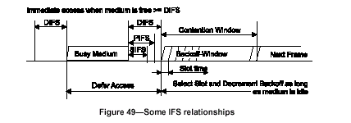
DCF MAC
Send immediately (after DIFS) if medium is idle
If medium was busy when sensed, wait a CW after it becomes idle (because many stations may be waiting when medium is busy; if they all send the instant the medium becomes idle, chances of collision are high)

Slide 26
PHY layer
Three physical layer specifications are part of 802.11
  Spread spectrum
    Frequency hopping (FH)
    Direct Sequence (DS)
  Infrared (IR)

Slide 27
FH
What is FH?
  Modulate the data signal such that it occupies different frequency bands as transmission progresses
  e.g., send a song over many FM radio channels with some dwell time per channel
  Why not FDMA?
  Multipath fading affects narrow frequency bands so that some channels offer very poor transmission
  In FH, time spent in each channel is small

Slide 28
802.11 FH PHY
79 non-overlapping 1Mhz channels used
1Mbps signals transmitted over the 2.4Ghz band
2400 – 2483.5Mhz
  83.5 Mhz of bandwidth (US: starts 2.402Ghz to 2.480 – so 79)
A channel hop occurs every 224 μs
78 hopping patterns
  Divided into 3 sets of 26 patterns each
  The sets are designed to avoid prolonged collision periods between hopping sequences in a set
  Hopping patterns collide 3 times on average, and 5 times in the worst case over a hopping cycle; each hop is a jump of a minimum of 6 channels
Each 802.11 LAN must use a particular hopping pattern
The hopping patterns allow for 26 networks to be collocated and still operate simultaneously

Slide 29
DS
Modulate data signal by a signal that occupies a much larger bandwidth
Chip rate: time to transmit a +1 or –1
To transmit a data bit, need 11 chip times
11 chip Barker sequence
To transmit +1, send
To transmit -1, send
+1
+1
+1
+1
+1
+1
+1
+1
+1
+1
+1
-1
-1
-1
-1
-1
-1
-1
-1
-1
-1
-1
11 symbol times
11 symbol times

Slide 30
802.11 DS
Takes a 1Mbps data signal and converts it into a 11 Mbps signal
11 channels in the 2.4Ghz band (5Mhz spacing)
Channels separated by center frequencies at least 30Mhz apart can operate without interference
If total bandwidth is only 83.5 Mhz, only 3 802.11 LANs using DS can have overlapping cells
FCC only allocates between 2412 and 2462

Slide 31
Ad-hoc vs. infrastructure based
Ad-hoc
  No fixed network infrastructure needed
  A wireless endpoint sends and all nodes within range can pick up signal
  Each packet carries destination and source address
  How do you know addresses of nodes in your region?
Infrastructure mode
  Access point receives and relay packets
  In 802.11, how does a node know whether to send a packet toDS or directly? – What is the DS?

Slide 32
Infrastructure based architecture
Extended Service Set
(ESS)
Distribution System (DS)
Access points (AP)
Basic
Service
Set (BSS)
Independent BSS (IBSS): has no AP
  adhoc mode; only wireless stations
Infrastructure BSS defined by stations sending Associations to register with an AP

Slide 33
802.11 MAC frame format
bytes
2
2
6
6
6
2
6
0-2312
4
Frame
control
Duration/
ID
Address
1
Address
2
Address
3
Seq.
control
Address
4
Frame body
FCS
MAC header
Protocol
version
Type
Sub-type
To
DS
From
DS
More
Frag
Retry
Pwr
Mgmt
More
Data
WEP
Order
bits
2
2
4
1
1
1
1
1
1
1
1

Slide 34
Field explanations
Type/sub-type field indicates the type of message
  Management:
    Association/Authentication/Beacon
  Control
    RTS, CTS, CF-end, ACK
  Data
    Data only, or Data + CF-ACK, or Data + CF-Poll or Data + CF-Poll + CF-ACK

Slide 35
Field explanations
To DS and From DS
To DS | From DS | Message
0 | 0 | station-to-station frames in an IBSS; all mgmt/control frames
0 | 1 | From AP to station
1 | 0 | From station to AP
1 | 1 | From one AP to another on DS
More Frag: 802.11 supports fragmentation of data
More Data: In polling mode, station indicates it has more data to send when replying to CF-POLL
RETRY is 1 if frame is a retransmission; WEP (Wired Equivalent Privacy)
Power Mgmt is 1 if in Power Save Mode; Order = 1 for strictly ordered service

Slide 36
Field explanations
Duration/ID: Duration in DCF mode/ID is used in PCF mode
Address fields
To DS | From DS | Address 1 | Address 2 | Address 3 | Address 4
0 | 0 | DA | SA | BSSID | N/A
0 | 1 | DA | BSSID | SA | N/A
1 | 0 | BSSID | SA | DA | N/A
1 | 1 | RA | TA | DA | SA
RA: Receiver Address TA: Transmitter Address
DA: Destination Address SA: Source Address
BSSID: MAC address of AP in an infrastructure BSS

Slide 37
Field explanations
Sequence control field
ACK frame
4 bits
12 bits
2
2
6
4 bytes
Fragment
number
Sequence
number
Frame
control
Duration
RA
FCS
Sequence control
  Sequence number remains the same for all retransmissions of an data unit
  Sequence numbers of all fragments of a data unit are the same
  Fragmentation Threshold determines size of fragments
  Maximum size of MAC frame payload is 2312 bytes
  Not included in ACK frame
    Broadcast and multicast frames are not ACK’ed

Slide 38
Features of 802.11 MAC protocol
Supports MAC functionality (address fields)
Error detection (FCS)
Error correction (ACK frame)
Fragmentation (More Frag)
Flow control: stop-and-wait

Slide 39
Registration
Why should an endpoint register with the access point:
  allows the AP to distribute frames to a station
Association, reassociation and disassociation
Views of 802.11
  view 802.11 as a wireless local area network
  view 802.11 link as a wireless access link

Slide 40
Data flow
Case 1: Packet from a station under one AP to another in same AP’s coverage area
Case 2: Packet between stations in an IBSS
Case 3: Packet from an 802.11 station to a wired server on the Internet
Case 4: Packet from an Internet server to an 802.11 station

Slide 41
Case 1 data flow
Access Point (AP)
ethernet
128.238.36
R
Internet
Dest: MAC B
To DS:1
Dest: MAC B
Access Point (AP)
MAC
A
From DS:1
MAC
C
MAC
B
Server
When a laptop registers with the AP, it knows that MAC B is in the same BSS and hence can participate in DCF MAC and send it

Slide 42
Case 2 data flow
Dest: MAC B
MAC
A
MAC
B
To DS:0
From DS:0
Direct transmit only in IBSS (Independent BSS), i.e., without AP
When AP is present, even if B can hear A, A sends the frame to the AP, and AP relays it to B
What is the exchange in an IBSS that lets A know that B is in range?

Slide 43
Case 3 data flow
DA: MAC R
Dest. IP: Server
ethernet
128.238.36
R
Internet
Access Point (AP)
MAC R
To DS:1
Access Point (AP)
MAC
B
MAC
C
MAC
A
Server
MAC A determines IP address of the server (using DNS)
From the IP address, it determines that server is in a different subnet
Hence it sets MAC R as DA;
  Address 1: BSSID, Address 2: MAC A; Address 3: DA
AP will look at the DA address and send it on the ethernet
  AP is an 802.11 to ethernet bridge
Router R will relay it to server

Slide 44
Case 4 data flow
ARP
Dest: 128.238.36.5
DA: MAC A; SA: MAC R
BSSID
ethernet
ARP reply
128.238.36
Access Point (AP) I
R
Internet
DMAC: A; SMAC: R
MAC R
ARP reply
ARP
Access Point (AP) II
MAC
A
MAC
B
MAC
C
128.238.36.6
128.238.36.5
128.238.36.7
Server
AP knows nothing of IP addresses; so it will simply broadcast ARP on its wireless link
DA = all ones – broadcast address on the ARP
MAC A host replies with its MAC address (ARP reply)
AP passes on reply to router
Router sends data packet, which the AP simply forwards because it knows that MAC A is registered
Will AP II broadcast the ARP request on the wireless medium? How about the data packet?

Slide 45
Reference
Chapter 6 of EE136 textbook:
  A. Leon-Garcia, I. Widjaja, “Communication Networks,”
  McGraw Hill.
The IEEE 802.11 specification – posted on my.poly.edu – reference materials
P. Brenner, “A Technical Tutorial on the IEEE 802.11 Protocol,” http://www.sss-mag.com/pdf/802_11tut.pdf

